Slide 1
AZ-104T00A Administer Azure Virtual Machines

Slide 2
Administer Azure Virtual Machines Overview
Configure Virtual Machines
Configure Virtual Machine Availability
Configure Virtual Machine Extensions
Lab 08 – Manage Virtual Machines

Slide 3
Configure Virtual Machines

Slide 4
Configure Virtual Machines Introduction
Review Cloud Services Responsibilities
Plan Virtual Machines
Determine Virtual Machine Sizing
Determine Virtual Machine Storage
Demonstration - Creating a VM in the Portal
Connect to Virtual Machines
Connect to Windows Virtual Machines
Connect to Linux Virtual Machines
Demonstration – Connect to Linux VMs (optional)
Summary and Resources

Slide 5
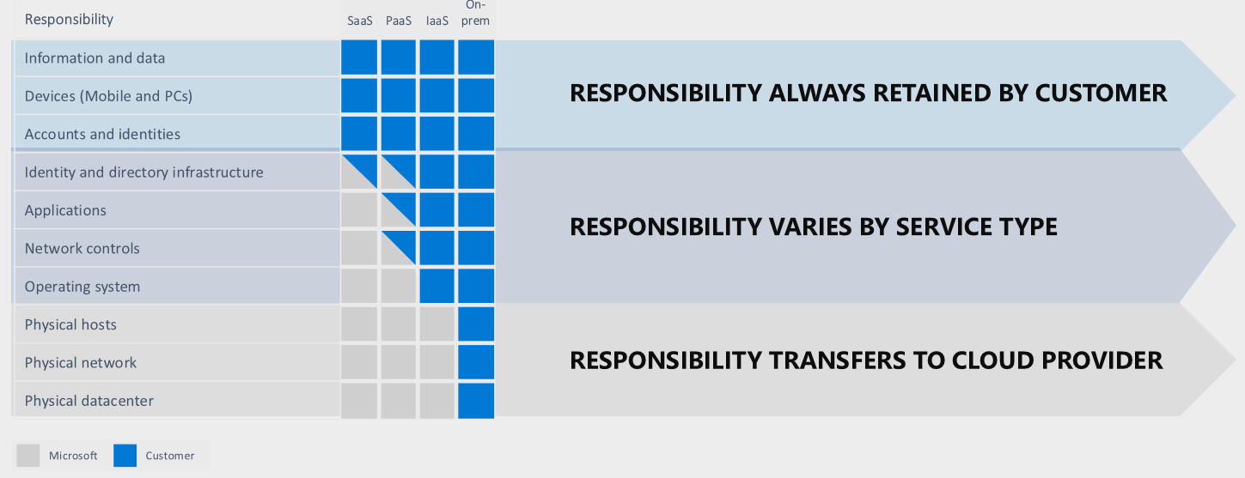
Review Cloud Services Responsibilities
Test and development, website hosting, storage, backup, recovery, high-performance computing, big data analysis, and extended data center
Notes:
Consider test and development
Consider website hosting
Consider storage, backup, and recovery
Consider high-performance computing
Talk about DC exit, modernisation, lift shift etc.

Slide 6
Plan Virtual Machines
Start with the network
Name the virtual machine
Choose a location
Each region has different hardware and service capabilities
Locate Virtual Machines as close as possible to your users and to ensure compliance and legal obligations
Consider pricing
60+ Azure regions
Available in 140 countries
Notes:
VM’s cannot be renamed (easily)
Which VM family will you use?
Which VM size?
Can VMs be resized?
What about licensing and running costs?
15 characters on a Windows virtual machine and 64 characters on a Linux virtual machine.
The machine location can limit your available options. Each region has different hardware available, and some configurations aren't available in all regions.
There are price differences between locations. To find the most cost-effective choice, check for your required configuration in different regions.
What are Azure Managed Disks?

Slide 7
Determine Virtual Machine Sizing
Type | Description
General purpose | Balanced CPU-to-memory ratio.
Compute optimized | High CPU-to-memory ratio.
Memory optimized | High memory-to-CPU ratio.
Storage optimized | High disk throughput and I/O.
GPU | Specialized virtual machines targeted for heavy graphic rendering and video editing..
High performance compute | Our fastest and most powerful CPU virtual machines
✔️ Share VM images in a compute gallery
Notes:
Examples
General purpose – dev test, small medium apps, testing
Compute – NVAs, medium applications, batch
Memory – databases, anatlyics
Storage – SQL, data warehouse
GPU – AVD with graphics requirements, simulations
High perf – fast performance, big number crunk, rapid network as VMs are optimized with RDMA
RDMA allows VMs to communicate and exchange data in RAM without relying on a processor/OS
Resizing machines is easy but within the same family – reboot required

Slide 8



Determine Virtual Machine Storage
Each Azure VM has two or more disks:
OS disk
Temporary disk (contents can be lost)
Data disks (optional)
Azure VM (Windows)
OS and data disks reside in Azure Storage accounts:
Azure-based storage service
Standard (HDD, SSD) or Premium (SSD), or Ultra (SSD)
C:\
OS disk
D:\
Temporary disk
F:\
Data disk
Azure VMs use managed disks – underlying storage is Azure page Blob storage but Azure manages the movement of the VHD files for you.
Azure blob
Notes:
Migration from Hyper-V?
VHD/VHDX both supported Gen 1 & Gen 2 – but only when VHD files are set to fixed size disks. Not dynamically expanding.
Temp disks – on Windows this is always D:\ by default on Linux it is /dev/sdb – no data should be stored on the temp disk.
Page and swap files is the only real purpose as the content will be lost when the VM reboots.
The Data disk configuration is related to the VM SKU and size
Premium – high perf, low latency, these are all based on SSD
Disk stripping – you can pool disk capacity and IOPS together up to 256TB per VM. This provides up to 80,000 IOPS

Slide 9
Azure VM Charges
Compute is billed on a per-minute basis.
Consumption based billing – you are only charged for the capacity you require. Good for unpredictable workloads. Resizing and deallocating VMs can help reduce costs.
Reserved Instances – a way to save VM consumption costs by committed to your required capacity over a 1 or 3 year period. This is good for predictable workloads. You can exchange reserved capacity if requirements change. Cost savings can be as much as 72% of the list VM price.
Storage – Azure VM storage is charged separately from the VM.
Notes:
Other charges?
Licensing? Talk about marketplace and BYOL
You can build and create your own images for VM deployment.

Slide 10
Demonstration – Creating a VM in the Portal
Create the virtual machine
Connect to the virtual machine
Install the Web Server role
View the IIS welcome page

Slide 11
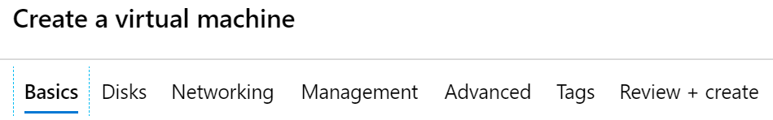
Create Virtual Machines in the Portal
Basic (required) – Project details, Administrator account, Inbound port rules
Disks – OS disk type, data disks
Networking – Virtual networks, load balancing
Management – Monitoring, Auto-shutdown, Backup
Advanced – Add additional configuration, agents, scripts or applications

Slide 12
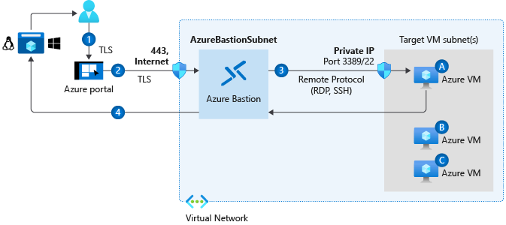
Connect to Virtual Machines
Bastion Subnet for RDP/SSH through the Portal over SSL
Remote Desktop Protocol for Windows-based Virtual Machines
Secure Shell Protocol for Linux based Virtual Machines
Notes:
Bastion? Does anyone know what a jump server is?
What security risks does opening SSH/RDP to the internet pose to a VM?
Could the VM be reached over a more secure channel?
Could we lock down the incoming routing/ACL rule to add security?
Linux VMs can authenticated to via password set at deployment or by a key pair
Bastion means no public IP is required on your VM

Slide 13
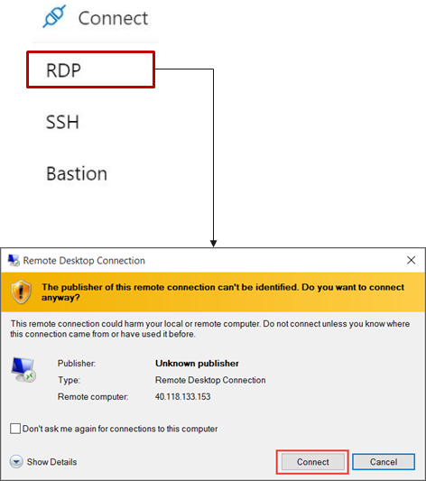
Connect to Windows Virtual Machines
Remote Desktop Protocol (RDP) creates a GUI session and accepts inbound traffic on TCP port 3389
WinRM creates a command-line session so you can run scripts

Slide 14
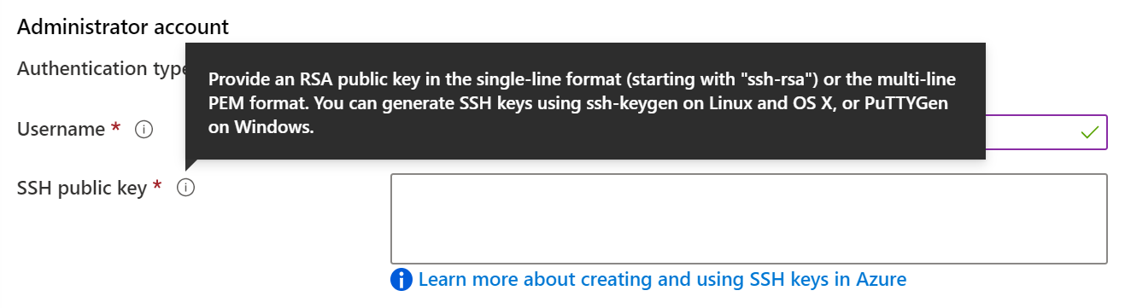
Connect to Linux Virtual Machines
Authenticate with a SSH public key or password
SSH is an encrypted connection protocol that allows secure logins over unsecured connections
There are public and private keys

Slide 15
Azure VM Disk Encryption
Azure Disk Encryption (ADE) helps protect and safeguard your data to meet your organizational security and compliance commitments. ADE encrypts the OS and data disks of Azure virtual machines (VMs) inside your VMs by using the DM-Crypt feature of Linux or the BitLocker feature of Windows. ADE is integrated with Azure Key Vault to help you control and manage the disk encryption keys and secrets.
Azure Disk Storage Server-Side Encryption (SSE) (also referred to as encryption-at-rest or Azure Storage encryption) automatically encrypts data stored on Azure managed disks (OS and data disks).

Slide 16
Demonstration – Connect to Linux VMs (optional)
Create the SSH keys
Create the Linux machine and assign the public SSH key
Access the server using SSH

Slide 17
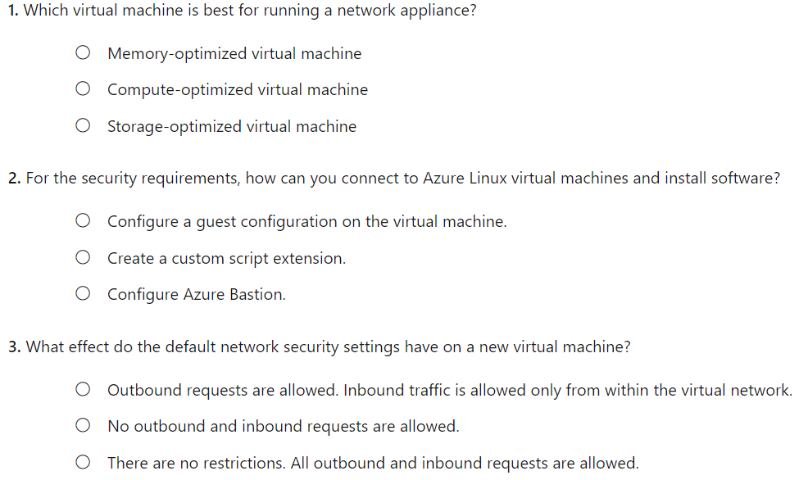
Knowledge Check
Notes:
B
C
A

Slide 18
Summary and Resources - Configure Virtual Machines
Knowledge Check Questions
Microsoft Learn Modules (docs.microsoft.com/Learn)
Introduction to Azure virtual machines (Sandbox)
Choose the right disk storage for your virtual machine workload
Create a Linux virtual machine in Azure (Sandbox)
Create a Windows virtual machine in Azure (Sandbox)
Connect to virtual machines through the Azure portal by using Azure Bastion
A sandbox indicates a hands-on exercise.

Slide 19
Configure Virtual Machine Availability

Slide 20
Configure Azure Virtual Machine Availability Introduction
Plan for Maintenance and Downtime
Setup Availability Sets
Review Update and Fault Domains
Review Availability Zones
Compare Vertical to Horizontal Scaling
Create Scale Sets (2 student topics)
Configure Autoscale (2 student topics)
Demonstration – Virtual Machine Scaling
Summary and Resources

Slide 21
Plan for Maintenance and Downtime
Unplanned Hardware Maintenance
Unexpected Downtime
Planned Maintenance
When the platform predicts a failure, it will issue an unplanned hardware maintenance event
Action: Live migration
Unexpected Downtime is when a virtual machine fails unexpectedly
Action: Automatically migrate (heal)
Planned Maintenance events are periodic updates made to the Azure platform
Action: No action
Notes:
An unplanned hardware maintenance event occurs when the Azure platform predicts that the hardware or any platform component associated to a physical machine is about to fail. When the platform predicts a failure, it issues an unplanned hardware maintenance event. Azure uses Live Migration technology to migrate your virtual machines from the failing hardware to a healthy physical machine. Live Migration is a virtual machine preserving operation that only pauses the virtual machine for a short time, but performance might be reduced before or after the event.
Unexpected downtime occurs when the hardware or the physical infrastructure for your virtual machine fails unexpectedly. Unexpected downtime can include local network failures, local disk failures, or other rack level failures. When detected, the Azure platform automatically migrates (heals) your virtual machine to a healthy physical machine in the same datacenter. During the healing procedure, virtual machines experience downtime (reboot) and in some cases loss of the temporary drive.
Planned maintenance events are periodic updates made by Microsoft to the underlying Azure platform to improve overall reliability, performance, and security of the platform infrastructure that your virtual machines run on. Most of these updates are performed without any impact to your virtual machines or Cloud Services.

Slide 22
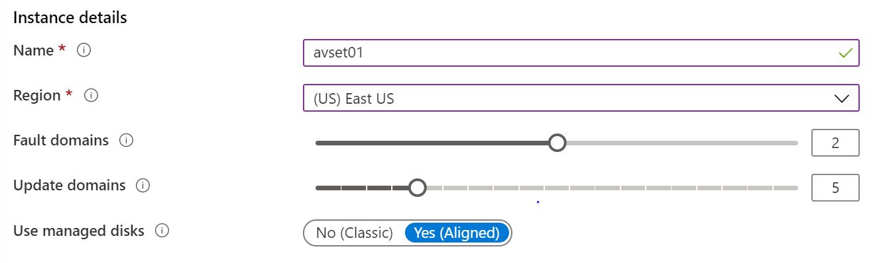
Setup Availability Sets
Two or more instances in Availability Sets = 99.95% SLA
Configure multiple Virtual Machines in an Availability Set
Configure each application tier into separate Availability Sets
Combine a Load Balancer with Availability Sets
Use managed disks with the Virtual Machines

Slide 23
Availability Set Design
All virtual machines in an availability set should perform the identical set of functionalities.
All virtual machines in an availability set should have the same software installed.
Azure ensures that virtual machines in an availability set run across multiple physical servers, compute racks, storage units, and network switches.
If a hardware or Azure software failure occurs, only a subset of the virtual machines in the availability set are affected. Your application stays up and continues to be available to your customers.
You can create a virtual machine and an availability set at the same time.
A virtual machine can only be added to an availability set when the virtual machine is created. To change the availability set for a virtual, you need to delete and then recreate the virtual machine.
You can create availability sets through the Azure portal in the Disaster recovery section.
Notes:
Adding your virtual machines to an availability set won't protect your applications from operating system or application-specific failures.
Redundancy
Separate app tiers
Load balancing
Managed disks

Slide 24
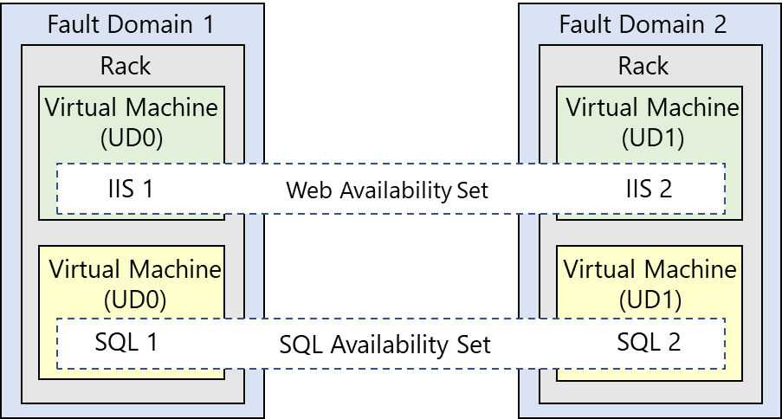
Review Update and Fault Domains
Update domains allows Azure to perform incremental or rolling upgrades across a deployment. During planned maintenance, only one update domain is rebooted at a time
Fault Domains are a group of Virtual Machines that share a common set of hardware, switches, that share a single point of failure. VMs in an availability set are placed in at least two fault domains
Notes:
Fault domain
Prevent Hardware failures like limit the impact of potential physical hardware failures, network outages, or power interruptions
1 Rack that share common power source and network switch.
Max- 3 FD per availability set, Default value=2
Update domain
Max= 20 UD, Default=5
Update domains indicate groups of virtual machines and underlying physical hardware that can be rebooted at the same time
The order of update domains being rebooted may not proceed sequentially during planned maintenance, but only one update domain is rebooted at a time. A rebooted update domain is given 30 minutes to recover before maintenance is initiated on a different update domain.

Slide 25
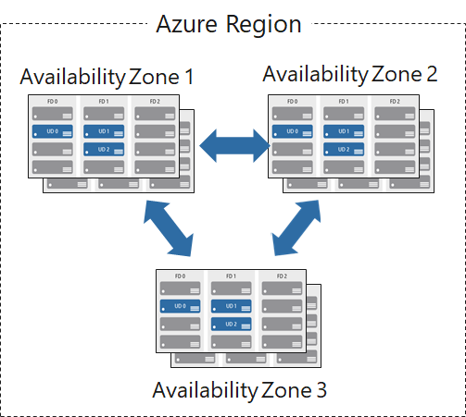
Review Availability Zones
Unique physical locations in a region
Includes datacenters with independent power, cooling, and networking
Protects from datacenter failures
Combines update and fault domains
Provides 99.99% SLA​
Notes:
Availability zones are unique physical locations within an Azure region.
Each zone is made up of one or more datacenters that are equipped with independent power, cooling, and networking.
To ensure resiliency, there's a minimum of three separate zones in all enabled regions.
The physical separation of availability zones within a region protects applications and data from datacenter failures.
Zone-redundant services replicate your applications and data across availability zones to protect against single-points-of-failure.
Zonal servicesAzure zonal services pin each resource to a specific zone.
Zone-redundant servicesFor Azure services that are zone-redundant, the platform replicates automatically across all zones.

Slide 26
Compare Vertical to Horizontal Scaling
Vertical scaling (scale up and scale down) is the process of increasing or decreasing power to a single instance of a workload; usually manual​
Horizontal scaling (scale out and scale in) is the process of increasing or decreasing the number of instances of a workload; frequently automated
Notes:
Vertical = increase/decrease VM size based on requriements
Example – scale down over weekend or when demand is less
Increase current VM size to meet performance needs without adding more instances
Horizontal – adding more VMs to an app tier
Example – dynamically scale horizontal with VMSS

Slide 27
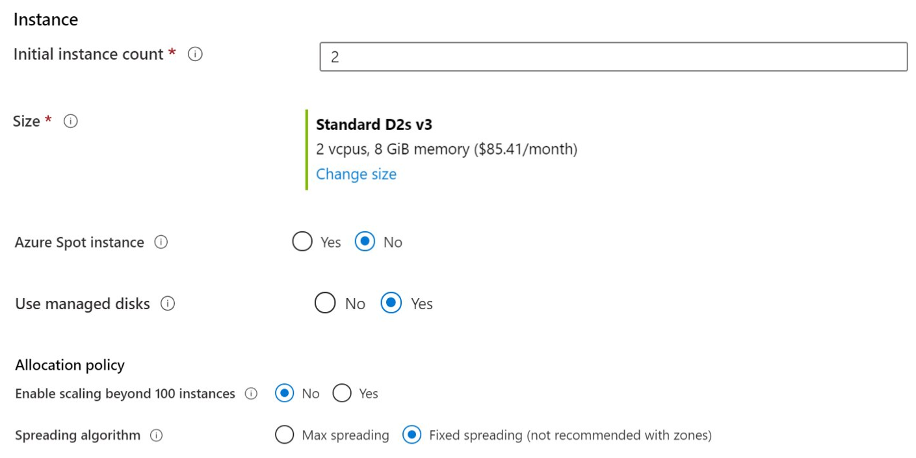
Create Scale Sets
Instance count. Number of VMs in the scale set (0 to 1000)
Instance size. The size of each virtual machine in the scale set
Azure Spot Instance. Unused capacity at a discounted rate
Use managed disks
Enable scaling beyond 100 instances
Notes:
All VMs must be identical
Enables elastic autoscaling
Auto increase/decrease of capacity based on demand
ALB/App GW can be provisioned in front of VMSS apps
Max of 1000 VMs with default Azure images – max 600 when using custom images
Azure Spot instance: Determine whether to enable the Azure Spot instance feature. When Azure Spot instance is enabled, low-priority virtual machines are allocated from Microsoft Azure's excess compute capacity. Azure Spot instances allow several types of workloads to run at a reduced cost.
Enable scaling beyond 100 instances: Identify your scaling allocation preference. If you select No, your Virtual Machine Scale Sets implementation is limited to one placement group with a maximum capacity of 100. If you select Yes, your implementation can span multiple placement groups with capacity up to 1,000. Selecting Yes also changes the availability characteristics of your implementation.
Spreading algorithm: Microsoft recommends allocating Max spreading for your implementation. This approach provides the optimal spreading.

Slide 28
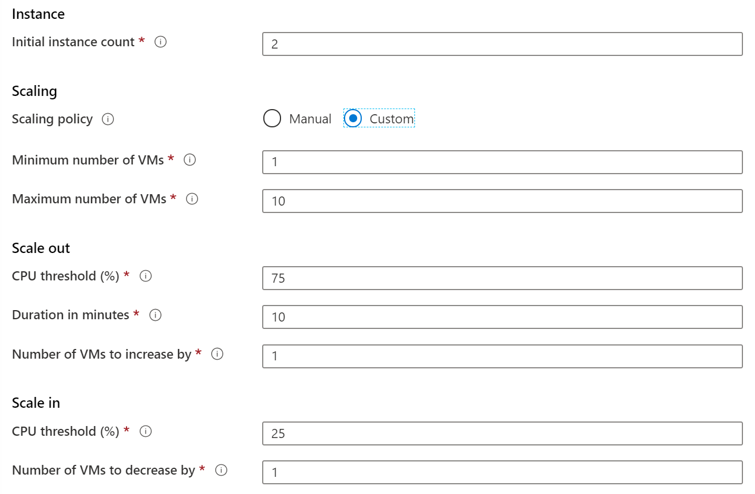
Configure Autoscale
Define a minimum, maximum, and default number of VM instances
Create more advanced scale sets with scale out and scale in parameters
Notes:
An Azure Virtual Machine Scale Sets implementation can automatically increase or decrease the number of virtual machine instances that run your application. This process is known as autoscaling. Autoscaling allows you to dynamically scale your configuration to meet changing workload demands.
Consider automatic adjusted capacity. You can create autoscaling rules to define the acceptable performance for a positive customer experience. When the defined thresholds are met, the autoscale rules act to adjust the capacity of your Virtual Machine Scale Sets implementation.
Consider scale out. If your application demand increases, the load on the virtual machine instances in your implementation increases. If the increased load is consistent, rather than a brief demand, you can configure autoscale rules to increase the number of virtual machine instances in your implementation.
Consider scale in. On an evening or weekend, your application demand might decrease. If the decreased load is consistent over a period of time, you can configure autoscale rules to decrease the number of virtual machine instances in your implementation. The scale-in action reduces the cost to run your Virtual Machine Scale Sets implementation as you only run the number of instances required to meet the current demand.
Consider scheduled events. You can implement autoscaling and schedule events to automatically increase or decrease the capacity of your implementation at fixed times.
Consider overhead. Using Azure Virtual Machine Scale Sets with autoscaling reduces your management overhead to monitor and optimize the performance of your application.

Slide 29


Demonstration – Virtual Machine Scaling
Create a scale out rule
Create a scale in rule

Slide 30
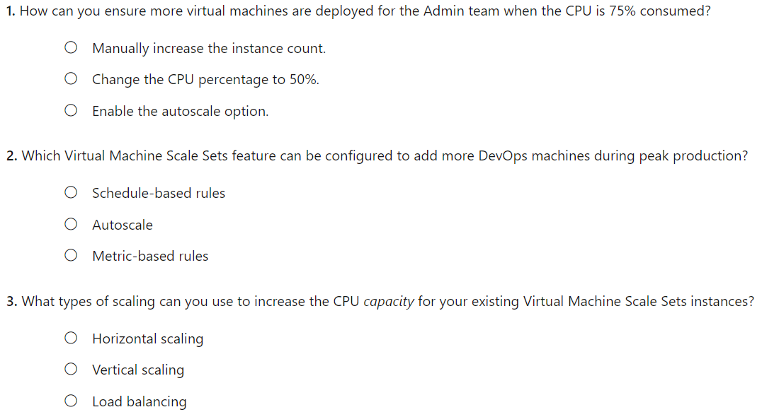
Knowledge Check
Notes:
C
A
B

Slide 31
Summary and Resources – Configure Virtual Machine Availability
Knowledge Check Questions
Microsoft Learn Modules (docs.microsoft.com/Learn)
Build a scalable application with virtual machine scale sets
Implement scale and high availability with Windows Server VM

Slide 32
Configure Virtual Machine Extensions

Slide 33
Configure Virtual Machine Extensions Introduction
Implement Virtual Machine Extensions
Implement Custom Script Extensions
Implement Desired State Configuration
Demonstration – Custom Script Extension (optional)
Summary and Resources

Slide 34
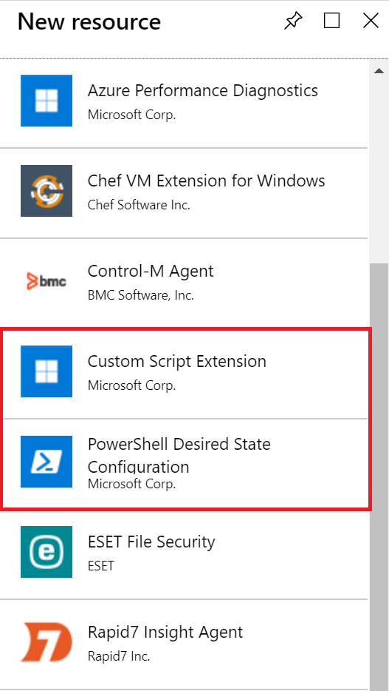
Implement Virtual Machine Extensions
Extensions are small applications that provide post-deployment VM configuration and automation tasks
Managed with Azure CLI, PowerShell, Azure Resource Manager templates, and the Azure portal
Bundled with a new VM deployment or run against any existing system
Different for Windows and Linux machines

Slide 35
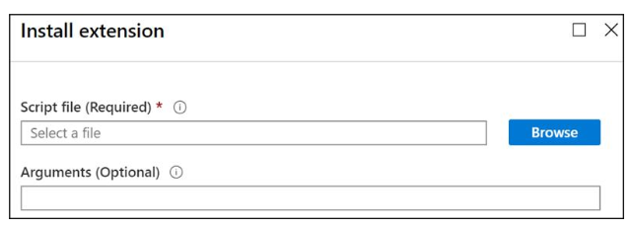
Implement Custom Script Extensions
Extension scripts can be simple or complex
Extensions have 90 minutes to run
Double check dependencies to ensure availability
Account for any errors that might occur
Protect/encrypt sensitive information
Notes:
A Custom Script Extension(CSE) can be used to automatically launch and execute virtual machine customization tasks post configuration. Your script extension may perform simple tasks such as stopping the virtual machine or installing a software component. However, the script could be more complex and perform a series of tasks.
You can install the CSE from the Azure portal by accessing the virtual machines Extensions blade. Once the CSE resource is created, you will provide a PowerShell script file. Your script file will include the PowerShell commands you want to execute on the virtual machine. Optionally, you can pass in arguments, such as param1, param2. After the file is uploaded, it executes immediately. Scripts can be downloaded from Azure storage or GitHub, or provided to the Azure portal at extension run time.

Slide 36
Implement Desired State Configuration
configuration IISInstall
{
Node “localhost”
{
WindowsFeature IIS
{
Ensure = “Present”
Name = “Web-Server”
}
}
}
Configuration block(s) have a name
Node blocks define the computers or VMs that you are configuring
Resource block(s) configure the resource and its properties
There are many built-in configuration resources
Notes:
Desired State Configuration (DSC) is a management platform in Windows PowerShell. DSC enables deploying and managing configuration data for software services and managing the environment in which these services run. DSC provides a set of Windows PowerShell language extensions, Windows PowerShell cmdlets, and resources that you can use to declaratively specify how you want your software environment to be configured. DSC also provides a means to maintain and manage existing configurations.
DSC centers around creating configurations. A configuration is an easy-to-read script that describes an environment made up of computers (nodes) with specific characteristics. These characteristics can be as simple as ensuring a specific Windows feature is enabled or as complex as deploying SharePoint. Use DSC when the CSE will not work for your application.

Slide 37
Demonstration – Custom Script Extension
Verify the Web Server feature is available on a virtual machine
Create a PowerShell script file to install the Web Server
Configure an Extension in the Portal to run the script
Verify the Web Server feature was installed

Slide 38
Summary and Resources - Configure Virtual Machine Extensions
Knowledge Check Questions
Microsoft Learn Modules (docs.microsoft.com/Learn)
Automate the configuration of Windows Server IaaS Virtual Machines
Protect your virtual machine settings with Azure Automation State Configuration (Sandbox)
A sandbox indicates a hands-on exercise.

Slide 39
Lab – Manage Virtual Machines

Slide 40
Lab 08 – Manage Virtual Machines
Lab scenario
You are tasked with identifying different options for deploying and configuring Azure Virtual Machines
Objectives
Task 1: Deploy zone-resilient Virtual Machines in the Azure portal and with templates
Task 2: Configure Azure Virtual Machines by using virtual machine extensions
Task 3: Scale compute and storage for Azure Virtual Machines
Task 4: Deploy zone-resilient scale sets by using the Azure portal
Task 5: Configure Azure virtual machine scale sets by using extensions
Task 6: Scale compute and storage for Azure virtual machine scale sets
Next slide for an architecture diagram

Slide 41









Lab 08 – Architecture diagram
Task 1
Task 2
Task 3, Task 4, Task 5, Task 6, Task 7
az104-08-rg01
az104-08-rg02
az104-06-vnet01 10.80.0.0/20
az104-08-rg02-vnet 10.82.0.0/20
Subnet0 10.80.0.0/24
Subnet0 10.82.0.0/24
az10408rg01diag938
az104-08-vm0
10.80.0.4
az104-08-vm1
10.80.0.5
az10408vmss0
az10408vmss0-lb
Zone1
Zone2
scripts
az10408vmss0-nsg
az10408vmss0-ip
az104-08-install_IIS.ps1

Slide 42

End of presentation

Slide 43
Planning Checklist
Start with the network
Understand the pricing model
Name the VM
Consider storage for the VM
Decide the location for the VM
Select an operating system
Determine the size of the VM

Slide 44
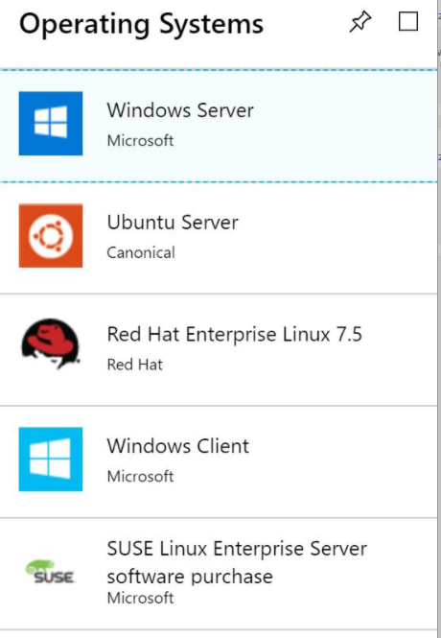
Supported Operating Systems
Windows Server includes many common products, requires a license, doesn’t support OS upgrades
Linux distributions are supported, upgrade of the OS is supported

Slide 45
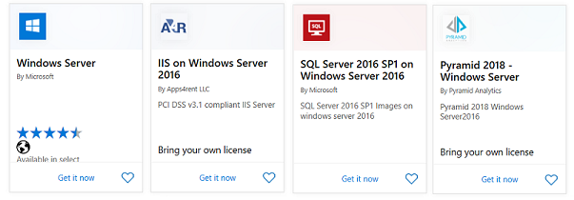
Windows Virtual Machines
Unique hybrid capabilities
Advanced multi-layer security
Faster innovation for applications
Unprecedented hyper-converged infrastructure

Slide 46
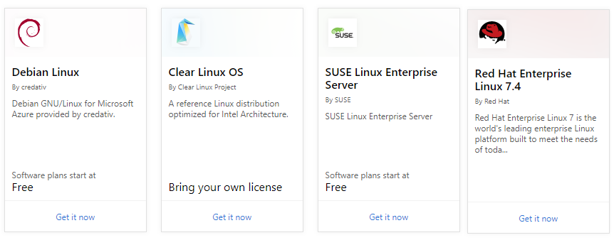
Linux Virtual Machines
Hundreds of community-built images in the Azure Marketplace
Linux has the same deployment options as for Windows VMs
Manage Linux VMs with many popular open-source DevOps tools

Slide 47
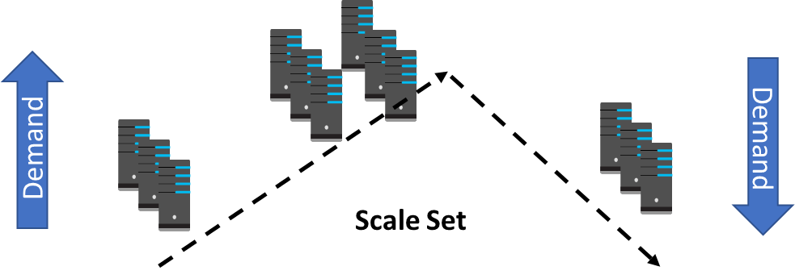
Implement Scale Sets
Scale sets deploy a set of identical VMs
No pre-provisioning of VMs is required
As demand goes up VMs are added
As demand goes down VM are removed
The process can be manual, automated, or a combination of both

Slide 48
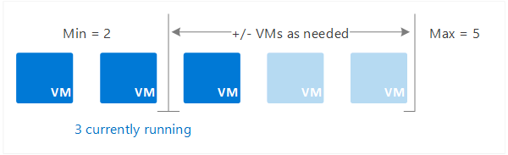
Implement Autoscale
Define rules to automatically adjust capacity
Scale out (increase) the number of VMs in the set
Scale in (reduce) the number of VMs in the set
Schedule events to increase or decrease at a fixed time
Reduces monitoring and optimizes performance

